Slide 1
Physiological Science Services
Dr. Sampath Gunawardena
Department of Physiology
Faculty of Medicine
University of Ruhuna

Slide 2
Physiological Science Services
Lung function tests (Spirometry)
Nerve conduction studies (Electroneurogram/electromyogram)
Electroencephalogram (EEG)
Electrocardiogram (ECG)
Hearing tests (Audiometry)
Visual field testing (Perimetry)
Serum osmolality /urine osomolality
Oesophageal pH /oesophageal manometry

Slide 3
Examinations and procedures
Lung function tests (spirometry )
To diagnose obstructive airways disease or restrictive lung diseases
Patient is allowed to rest before the test
Proper instructions/demonstration of the procedure before doing the test
Same procedure repeated three times and best readings are taken

Slide 4
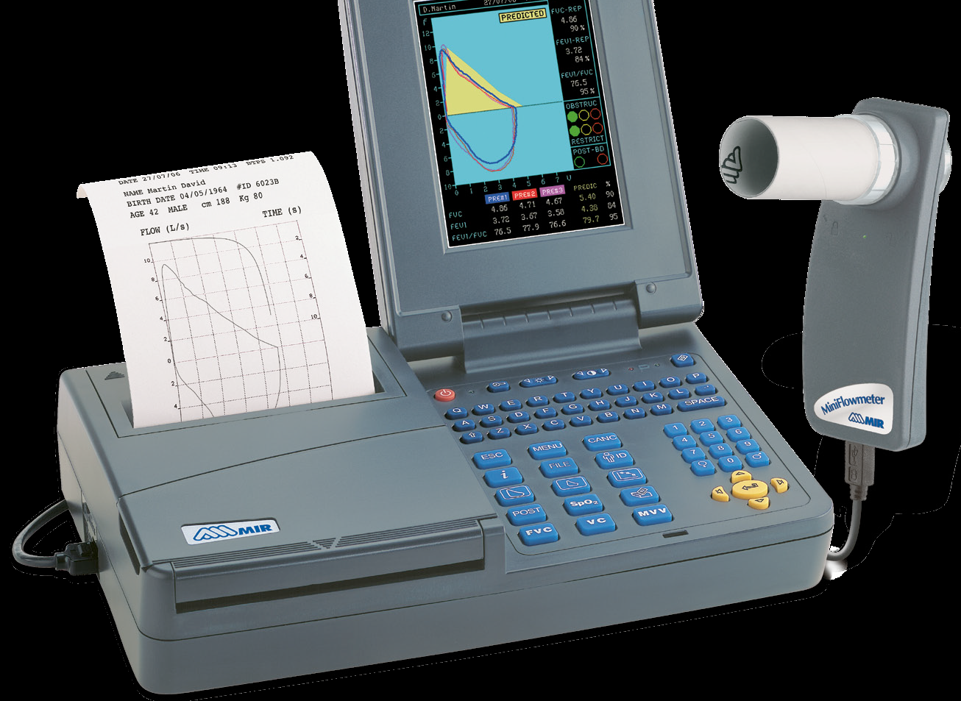
Spirometer

Slide 5
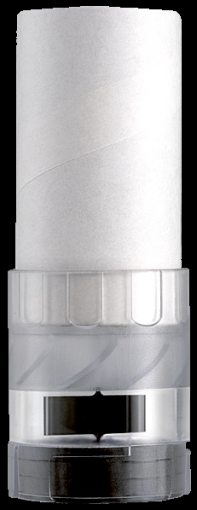
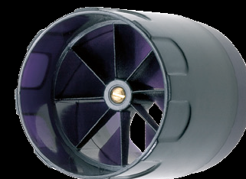
Safety Issues
Spreading infections – e.g. TB
Always use a new mouth-piece
Use a disposable turbine or wash the reusable turbine after use
Patient’s fitness

Slide 6
Calibration
Best if the flow rate is calibrated
Usually volume calibration is done
Some newer machines say not compulsory to calibrate
3 L Calibration Syringe

Slide 7
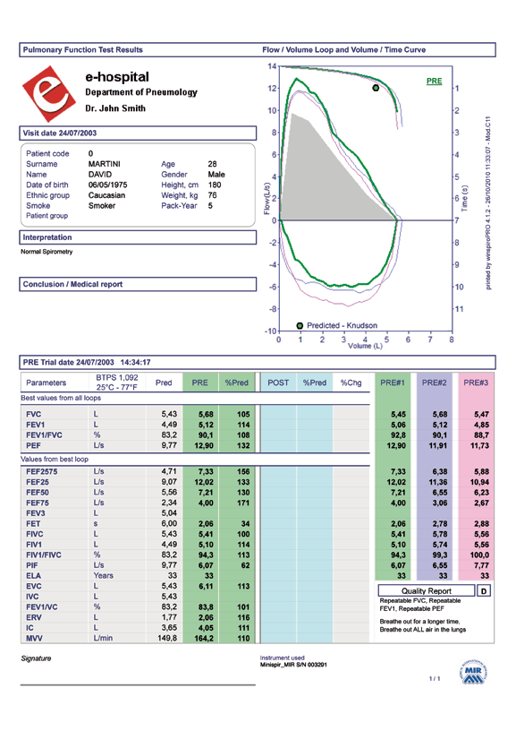
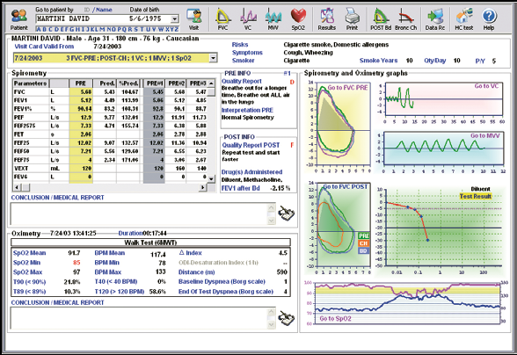
Issuing of the Report

Slide 8
Issuing of the Report contd…
It is important to note whether the patient properly followed the instructions when doing the test (Encourage and cheer-up the patient)
Make a note on the report regarding this
Poor attempt may look like restrictive lung disease!
Always give a feedback to the patient regarding his or her test result

Slide 9
Quality control and Quality Assurance
Quality control – to make sure the machine is able to measure the required parameters correctly (Calibration)
Quality Assurance – covers wider area –to make sure that in each of the patient when the testing is done whether all the efforts are taken to obtain a correct reading (including quality control) – Effort, repeatability, elimination of technical or patient errors etc

Slide 10
Issues with other tests

Slide 11
ECG
Leads should be placed at the proper place
Good contact with the skin – Using ECG paste, cleaning the suction cups
Look at the calibration signal (1mv = 10mm)
Proper grounding
Cables and connections should be maintained

Slide 12
Perimetry
Calibration – Intensity of the light should be tested for correct lumens. If required bulb has to be replaced
Accurate instructions – Not to move the eye – examiner can check it. To press the button as soon as a light is seen
Patient may feel sleepy in the dark environment and not respond

Slide 13
Audiometry
Calibration – for pure tone correct frequency/decibel sound
Proper instructions
Examiner should master the technique

Slide 14
Serum / Urine osmolality
Calibration of the equipment (different osmlarities – 100, 300, 500, 850, 2000 mosm/kg) – Zero calibration with distilled water
Storing the sample properly – do not allow to evaporate- Readings may be erroneously high

Slide 15
Take home message
Calibration and maintenance of equipment is important as with any other instrument
A good interaction between patient and investigator is vital in obtaining correct results
The End

